Slide 1
Project Proposal Title
Ryan Leveille
Dustin Vasquez

Slide 2
Introduction (RL)
We are interested in the factors that effect GDP per employee (productivity by employee) in both emerging and developing countries.
We both have an interest in economics. We thought this would be a fun dataset to work on.

Slide 3
Introduction (RL)
We want to find meaningful factors that effect employee productivity (GDP per employee) across countries.

Slide 4









Slide 5
Hypothesis and Questions
We believe access to electricity will positively effect employee productivity.
We believe internet usage will positively effect employee productivity.
We believe communication usage will positively effect employee productivity.
What are the effects of different industry trends on employee productivity?
What are the effects of employment type trends on employee productivity?

Slide 6

Data
https://databank.worldbank.org/source/jobs
20 different countries (10 developing, 10 developed)
15 year time frame (2000 – 2014)
300 Cases total

Slide 7
Data Preparation (RL)
Selecting correct data from data set
World Bank provides data in a reversed format for easy analysis, so we will have to reformat the data using Python.
There are missing values that will need filled/estimated using Python.

Slide 8
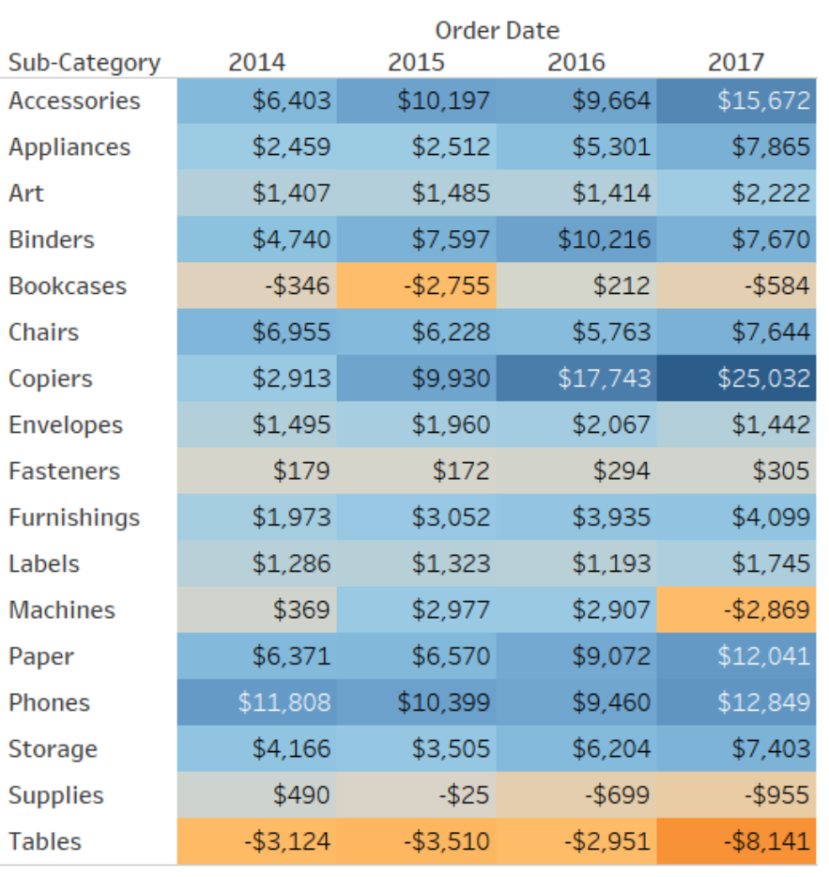
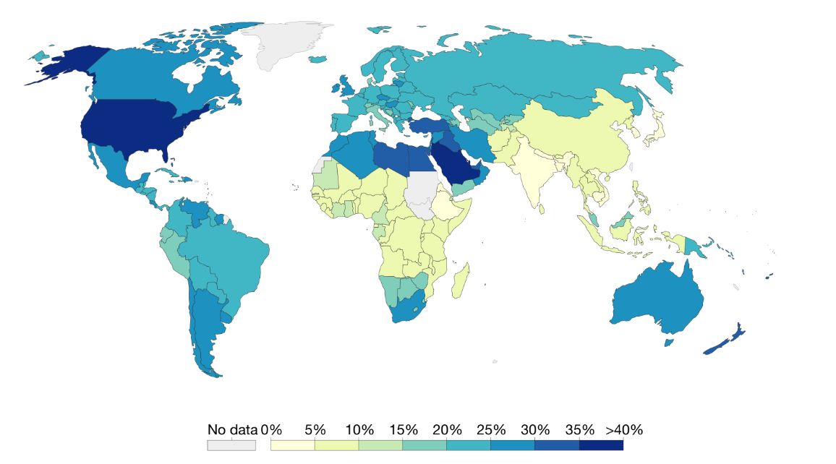
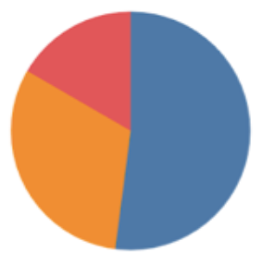
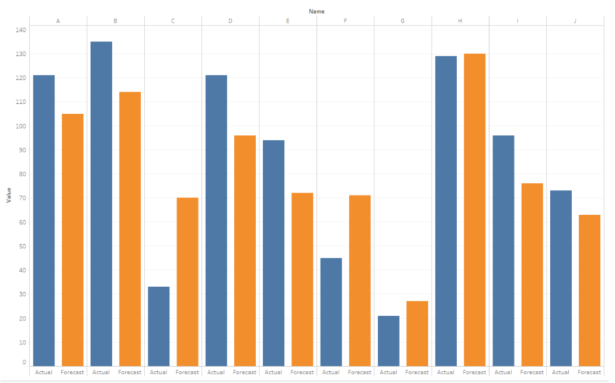
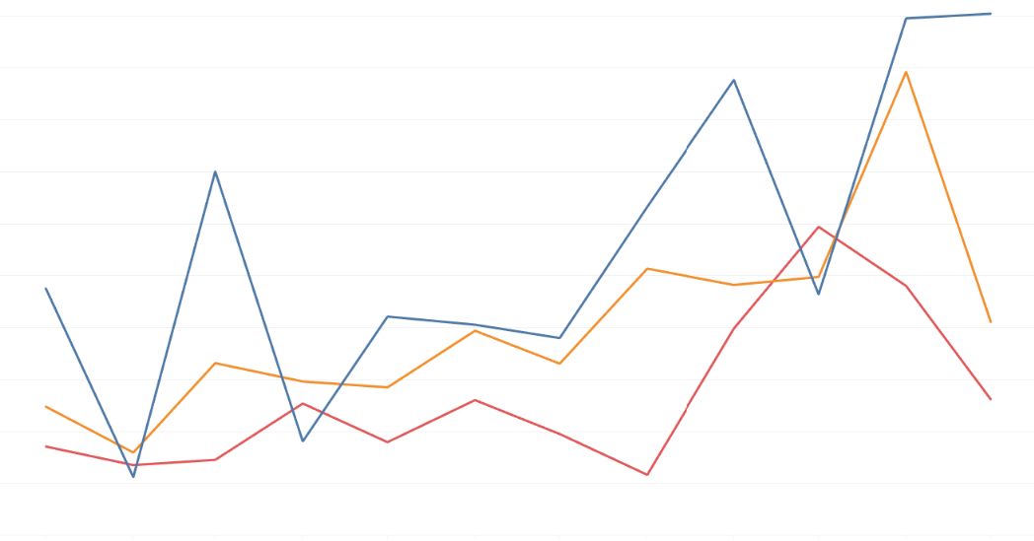
Visual Analysis

Slide 9
Tentative Schedule
Task | Date (Start)
Download Data | February 21, 2020
Prepare Data | March 5, 2020
Explore and Learn Data | March 19, 2020
Visual Analysis | April 9, 2020
Final Project Due | April 23, 2020

Slide 10
Thank You!

